Slide 1
Business Process Modelling and Enterprise Architecture
Version Control (½)
Rumali Sirimanne

Slide 2
Session Plan
What is Version Control ?
Uses of Version Control
Version Control System (VCS)
Centralised Version Control
Distributed Version Control
Features of VCS

Slide 3

What is Version Control ?
Version control
  a.k.a revision control or source control
  managing multiple versions of documents, programs, web sites, etc.
Allows programmers to keep track of every revision
How different is version control from back-up ?
  Back-up is usually time based (Mac Time Machine)
  Version control is about line of work

Slide 4
Uses of Version Control
Version control is not just useful for collaborative working, essential for quality source code development
Often want to undo changes to a file
  start work, realize it's the wrong approach, want to get back to starting point
  like "undo" in an editor…
  keep the whole history of every file and a changelog
Also want to be able to see who changed what, when
  The best way to find out how something works is often to ask the person who wrote it

Slide 5
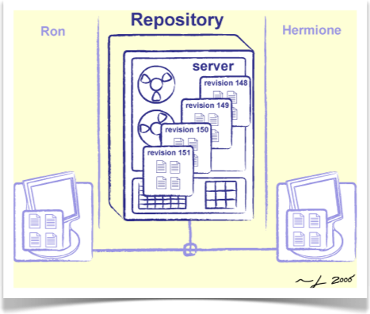
Version Control System (VCS)
A system which allows for the management of a code base
  Files are kept in a repository
  Repositories can be local or remote to the user
  The user edits a copy called the working copy
  Changes are committed to the repository when the user is finished making changes
  Other people can then access the repository to get the new code
Types of VCS
  Centralised Version Control System
  Distributed Version Control System

Slide 6
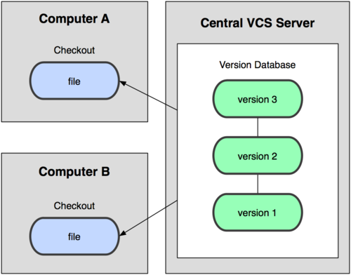
Centralised Version Control
A single server holds the code base
Clients access the server by means of check-in/check-outs
Examples include CVS, Subversion, Visual Source Safe.
Advantages: Easier to maintain a single server.
Disadvantages: Single point of failure.

Slide 7
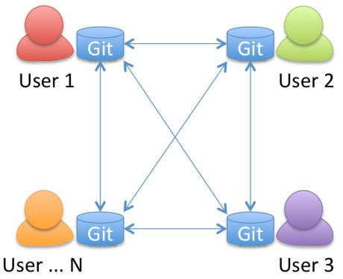
Distributed Version Control
Each client (essentially) holds a complete copy of the code base.
Code is shared between clients by push/pulls
Advantages: Many operations cheaper. No single point of failure
Disadvantages: A bit more complicated!

Slide 8
Features of VCS
Essential Features
  Check-in and check-out of items to repository
  Creation of baselines (labels/tags)
    Version 1.0 released!
  Control and manipulation of branching
    management of multiple versions
  Overview of version history
Additional Features
  Code Responsibility and Code Audits
  Forking (Common with Open Source)
  Metrics

Slide 9
Business Process Modelling and Enterprise Architecture
Version Control (½)
Rumali Sirimanne

